Slide 1
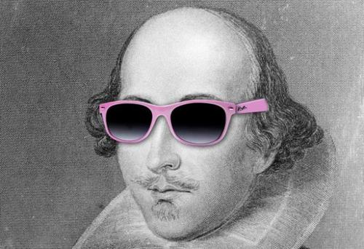
Will the real Shakespeare please stand up?
This Photo by Unknown Author is licensed under CC BY
Notes:
NOTE:
To change the image on this slide, select the picture and delete it. Then click the Pictures icon in the placeholder to insert your own image.

Slide 2
Controversy
Access to Books
Proper Education
Royal Connection
Recorded History

Slide 3
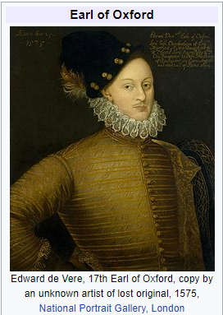
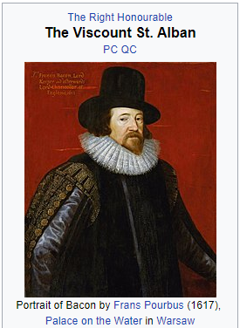
Possibilities
Suspect | Edward de Vere | Sir Francis Bacon
Brief History | Earl of Oxford Well known for his poetry and plays. | Philosopher, poet, lawyer, and statesman. Father of scientific theory.
Evidence | Oxfordian School of Thought https://shakespeareoxfordfellowship.org | Baconian School of Thought http://www.sirbacon.org/links/evidence.htm

Slide 4
Methodology
Gather Documents
SHAKESPEARE
100 Sonnets
DE VERE
20 Poems
15 Letters
BACON
19 Essays
Remove Stop Words
English words included with R tm library.
Elizabethan stop words.
Exploration
Words Counts
Word Cloud
Analysis
Decision Tree
K-Means
Word association
Top Words
Support Vector Machine

Slide 5

Gather Documents
SHAKESPEARE
100 Sonnets
DE VERE
20 Poems
15 Letters
BACON
19 Essays

Slide 6

Stopwords Lists
TM Library for R
Elizabethan Stop Words
[1] "i" "me" "my" "myself" "we" [6] "our" "ours" "ourselves" "you" "your" [11] "yours" "yourself" "yourselves" "he" "him" [16] "his" "himself" "she" "her" "hers" [21] "herself" "it" "its" "itself" "they" [26] "them" "their" "theirs" "themselves" "what" [31] "which" "who" "whom" "this" "that" [36] "these" "those" "am" "is" "are" [41] "was" "were" "be" "been" "being" [46] "have" "has" "had" "having" "do" [51] "does" "did" "doing" "would" "should" [56] "could" "ought" "i'm" "you're" "he's" [61] "she's" "it's" "we're" "they're" "i've" [66] "you've" "we've" "they've" "i'd" "you'd" [71] "he'd" "she'd" "we'd" "they'd" "i'll" [76] "you'll" "he'll" "she'll" "we'll" "they'll" [81] "isn't" "aren't" "wasn't" "weren't" "hasn't" [86] "haven't" "hadn't" "doesn't" "don't" "didn't" [91] "won't" "wouldn't" "shan't" "shouldn't" "can't" [96] "cannot" "couldn't" "mustn't" "let's" "that's" [101] "who's" "what's" "here's" "there's" "when's" [106] "where's" "why's" "how's" "a" "an" [111] "the" "and" "but" "if" "or" [116] "because" "as" "until" "while" "of" [121] "at" "by" "for" "with" "about" [126] "against" "between" "into" "through" "during" [131] "before" "after" "above" "below" "to" [136] "from" "up" "down" "in" "out" [141] "on" "off" "over" "under" "again" [146] "further" "then" "once" "here" "there" [151] "when" "where" "why" "how" "all" [156] "any" "both" "each" "few" "more" [161] "most" "other" "some" "such" "no" [166] "nor" "not" "only" "own" "same" [171] "so" "than" "too" "very"
[1] "art" "can" "doth" "dost" "'ere" "hast" "hath" "hence" "hither"
[10] "nigh" "oft" "should'st" "thither" "tither" "thee" "thou" "thine" "thy"
[19] "'tis" "'twas" "wast" "whence" "wherefore" "whereto" "will" "withal" "would'st"
[28] "ye" "yon" "yonder" "lordship" "come" "cause" "also" "use" "said"
[37] "see" "other" "say" "exeunt" "ham" "man" "men" "shall"
This Photo by Unknown Author is licensed under CC BY-SA

Slide 7
Exploration – WORD COUNTS
Total Words per Author
Most Common Words
Love
Good
Time
Yet
Make
Author | Word Count
Shakespeare | 5438
Bacon | 5348
De Vere | 4556
Word Count Variance
Minimum | 1st Quartile | Median | Mean | 3rd Quartile | Maximum
22 | 52 | 58 | 98.98 | 107 | 508

Slide 8
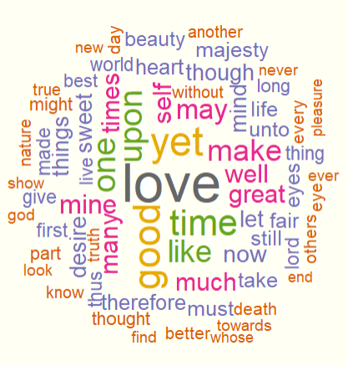
Exploration – WORD CLOUD AND WORD ASSOCIATIONS
Time |  | Love |  | Good
rejected | 0.65 | absurdly | 0.68 | otherwise | 0.68
course | 0.60 | admit | 0.68 | thing | 0.61
continuance | 0.58 | alteri | 0.68 | citizen | 0.60
cutting | 0.54 | amorous | 0.68 | things | 0.60
speeches | 0.52 | antonius | 0.68 | affect | 0.55

Slide 9
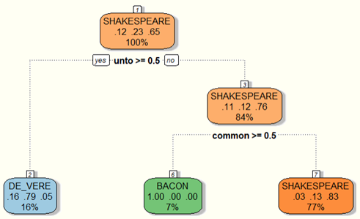
Analysis – DECISION TREE
Reasons
Mosteller and Wallace used a single word to identify the author of the disputed Articles of Federation.
Accuracy: ~70%
Kappa ~29%
Confidence Interval: 52% - 83%

Slide 10
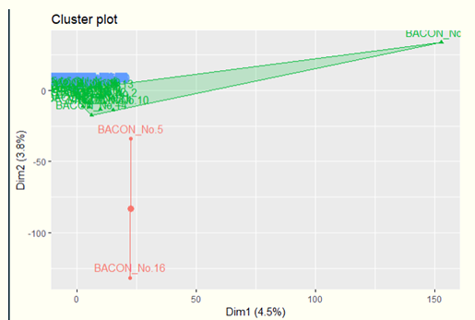
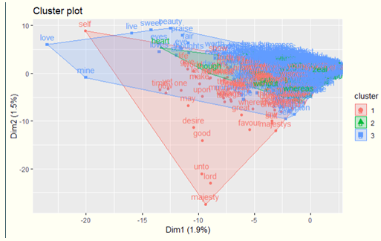
Analysis – K-MEANS
Reasons
Attempt to group by author
Attempt to group by document/ piece

Slide 11
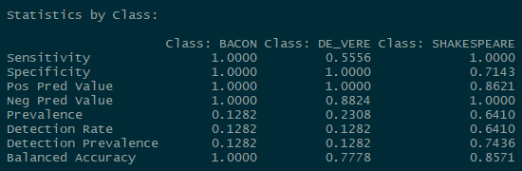
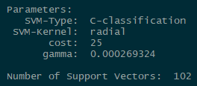
Analysis – SUPPORT VECTOR MACHINE
Reasons
Works with both regression or categorical problems
Tries to find a hyperplane between categories to exploit differences
Accuracy: ~92%
Kappa ~79%
Confidence Interval: 76% - 97%

Slide 12
Conclusion
Further testing using a variety of plays.
More fine tuning may increase performance.
These three authors all have similar word usage and associations in all of their works.

